Slide 1

#LifeKoKaroLift
Data Science Program
‹#›

Slide 2


Module Name: EDA & Statistics
Course : EDA
Lecture On : EDA - Day - 4
Instructor :
‹#›

Slide 3


Slide 4
Today’s Agenda
Revision
Numeric - Numeric Analysis
Correlation vs Causation
Numerical - Categorical Analysis
Categorical - Categorical Analysis
Multivariate Analysis
Key Takeaways
Data Science Certification Program
‹#›

Slide 5

Revision
In previous session, we learnt about:
Introduction to Univariate Analysis
Categorical Unordered Univariate Analysis
Categorical Ordered Univariate Analysis
Statistics on Numerical Features

Slide 6
Numerical-Numerical Analysis
We will learn how to analyse two numerical variables using the bank marketing dataset.
There are multiple tools to analyse numerical variables. We will learn about the different tools and plots that are helpful for extracting insights using numerical variables from a data set.
A very important concept is the correlation coefficient. The correlation coefficient depicts only a linear relationship between numerical variables; it does not depict any other relationship.
A zero correlation does not imply that there is no relationship between variables; it merely indicates that there will be no linear relationship between them.
Also, there can be a negative or positive correlation between variables. A negative correlation means that if the value of one variable increases, the value of the other decreases, whereas it is the opposite for a positive correlation.

Slide 7
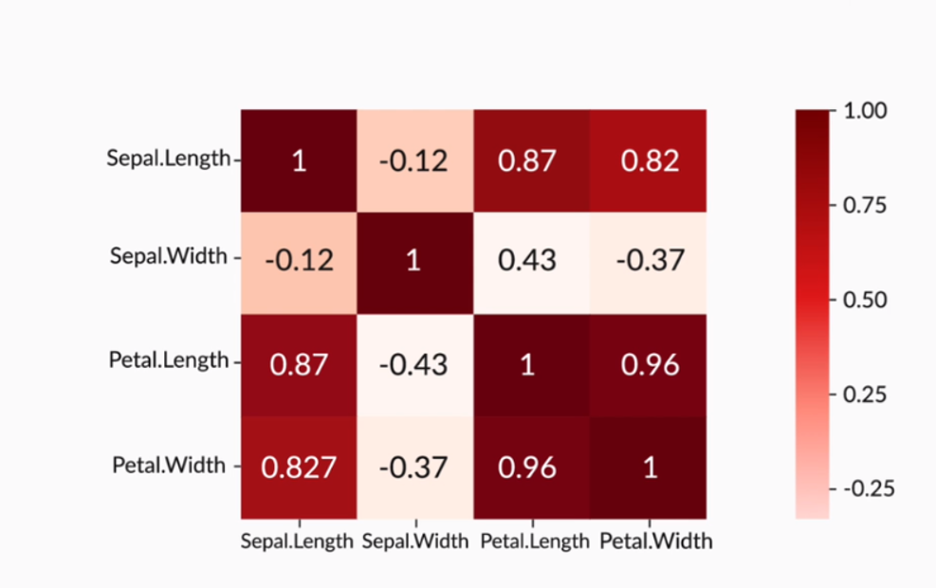
Numerical-Numerical Analysis
The higher the value (absolute value) of the coefficient of correlation between numerical variables, the higher the linear relation between them.
From the correlation matrix below, you can observe that petal length has a high correlation with sepal length – a correlation coefficient of 0.87. Also, there is a very high correlation coefficient of 0.96 between petal width and petal length.

Slide 8
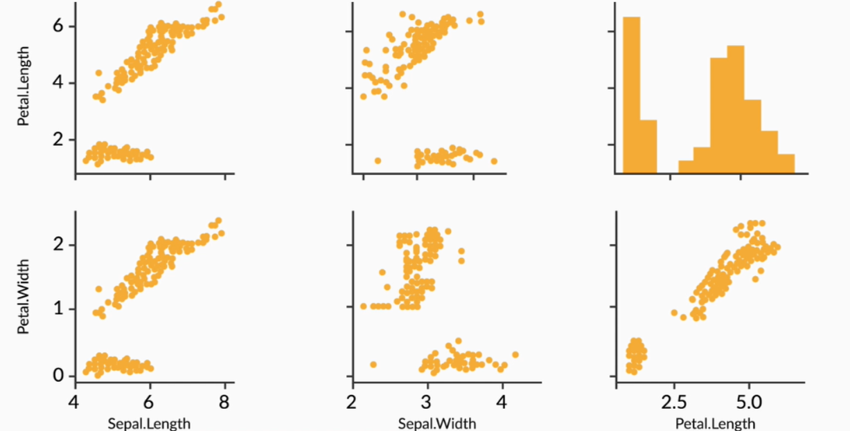
Numerical-Numerical Analysis
However, the correlation matrix has its own limitations where you cannot see the exact distribution of a variable with another numeric variable.
To solve this problem, we use pair plots. Pair plots are scatter plots of all numeric variables in a data set. It shows the exact variation of one variable with respect to other variables.
You can observe how one variable is varying with respect to another in the image below.

Slide 9
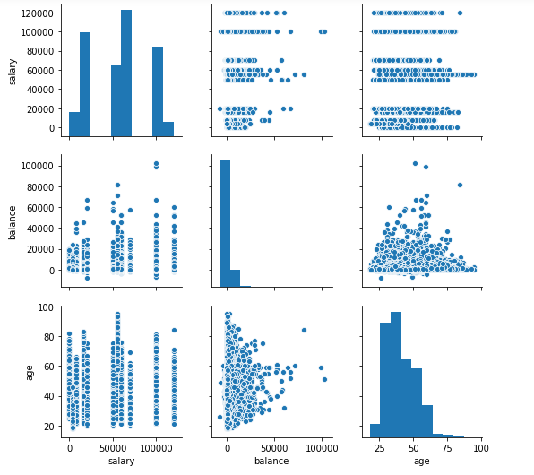
Numerical-Numerical Analysis
Now, refer to the image below and observe how there is no correlation between these variables.
A high correlation coefficient does not imply that there will be a correlation with another numeric variable every time because there can be no causation between them.
There may be cases when you will see a high correlation coefficient between two variables, but there is no relation between them.

Slide 10
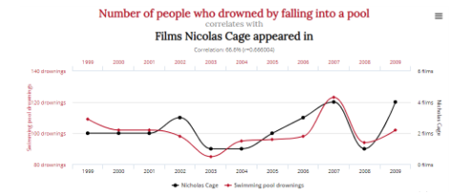
Correlation vs Causation
In the EDA exercise, it is very important to note that although some numerical variables can sometimes be highly correlated, there may not be a cause of any relationship between them.
The correlation does not imply causation. We can see that the number of people who drowned by falling into a pool is not related to movies starring Nicolas Cage.
However, if you observe the plot below, you will notice a very high correlation between them, as both the plots follow almost the same path.

Slide 11
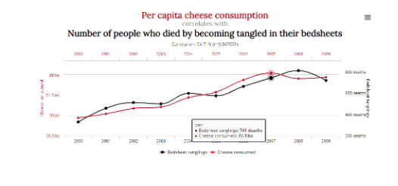
Correlation vs Causation
Similarly, in the example below, it is obvious that the per capita cheese consumption has no relation with people dying from being tangled in bedsheets. However, the plot shows a high correlation between them.
For more such compelling examples, where causation and correlation are not related, you can refer to this link.

Slide 12
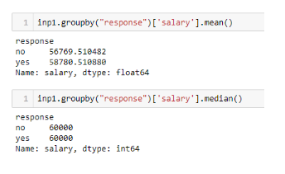
Numerical-Categorical Analysis
Now, we will learn about the associations between numerical and categorical variables and how to apply this analysis to the same bank marketing dataset.
From the dataset, you saw how the salary variable varied with respect to the response variable. Their mean and median are the same, as shown in the image below.

Slide 13
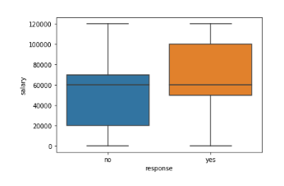
Numerical-Categorical Analysis
However, a very different picture emerges when you plot a boxplot. The interquartile range for customers who gave a positive response is on the higher salary side.
This is actually true, because people who have higher salaries are more likely to invest in term deposits.

Slide 14
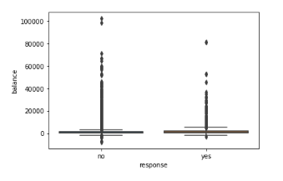
Numerical-Categorical Analysis
We can also observe that the balance vs response graph does not make any sense at first glance.
Sometimes only a boxplot is not sufficient to draw insights because of high concentration of data and/or higher values in the data set; for example, the balance variable.
In such cases, it is a good practice to analyse the data using mean, median or quartiles.
We can see that the mean and median values of the balance variable are higher for customers who gave a positive response, which is again true because people with higher bank balance are more likely to invest in term deposits.

Slide 15
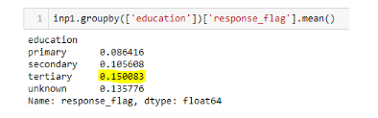
Categorical - Categorical Analysis
We will now learn about the associations between two categorical variables in bivariate analysis.
Statistical analysis is essential for numerical variables. It includes different metrics like mean, median, mode, quantiles and boxplots.
Let’s learn how to analyse categorical variables using graphs and charts and derive maximum insights from them.
We will see that the positive response of customers to opening a term deposit with the bank increases with the education level.
From this, you can infer that the bank should contact people with higher education levels to effectively increase the positive response for opening a term deposit.

Slide 16
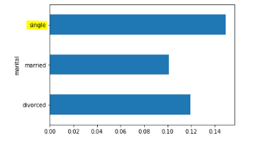
Categorical - Categorical Analysis
Also, based on marital status analysis, you can infer that single individuals have a higher positive response rate.
This could be due to various reasons: one reason could be that compared with other categories of customers, single individuals have the available income to deposit in long-term savings accounts (term deposit). Hence, the campaign should target single customers.

Slide 17
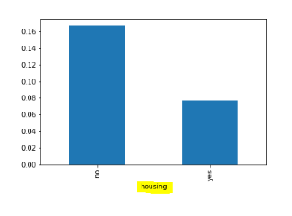
Categorical - Categorical Analysis
Another very interesting inference is that people who have not purchased any housing or personal loan are more likely to open a term deposit account with the bank.
This might be true, because people who have already availed loans may not have the necessary funds to invest in a term deposit.

Slide 18
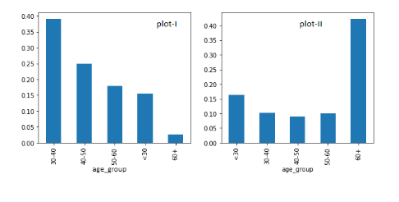
Categorical - Categorical Analysis
Now, let’s study the association between the age variable and response rate.
So, age group analysis showed that people in the age group of 60+ or <30 are more likely to respond positively.
It may be true for older people since they want to invest through more secure investment methods such as term deposits to have a secure old age.

Slide 19
Multivariate Analysis
Now, let’s analyse two variables simultaneously. One of the key features of multivariate analysis is that it gives you a precise idea about the various elements since you are now combining multiple variables to visualise the data set.
We performed a three-variable analysis between education, marital status and response.
You can see that people who are married and who have completed just their primary education are least likely to give a positive response on term deposits.
This can be explained by the fact that people educated only up to the primary level are not aware of the benefits of term investments.
Also, married individuals need money to fulfil their daily needs, and they require cash on hand to buy the daily essentials; hence, they will not prefer investing in term deposits.

Slide 20
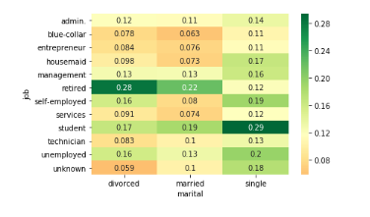
Multivariate Analysis
We can see that the married–blue-collar, or married–entrepreneur and married–housemaid combinations are least likely to go for term deposits.
The highest rate of positive responses came from students with single marital status. The bank should, therefore, consider these aspects before taking any decision.

Slide 21
Key Takeaway
Revision
Numeric - Numeric Analysis
Correlation vs Causation
Numerical - Categorical Analysis
Categorical - Categorical Analysis
Multivariate Analysis
Key Takeaways
Data Science Certification Program
‹#›

Slide 22
#LifeKoKaroLift
Thank You!
‹#›

